Slide 1

Prepared by:
Mahmoud Ehab Mahmoud Abdeen.
Ahmed Khaled Mohana Tohamy.
Mariam Mohamed Abdelmonem Ismail.
Under supervision of
DR/Manal showman

Slide 2


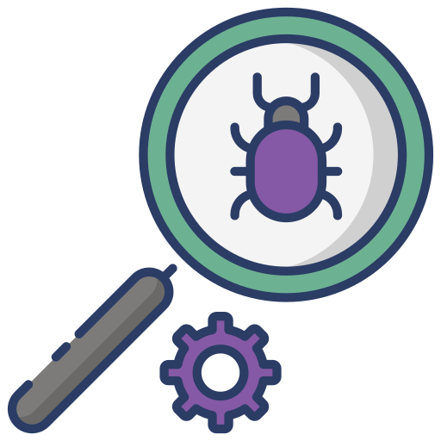
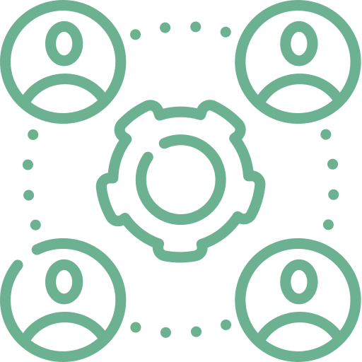

Non-fun.
Introduction
Modules
Diagrams
Log out

Slide 3
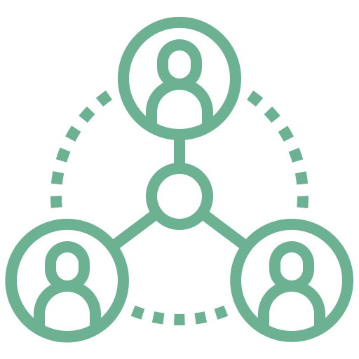


Introduction
Purpose
Stakeholders
End Product
purpose of the software is to track bugs and allow the end user to manage bugs and store them if they ever appear in other projects.
Administrator.
Developer.
Tester.
Desktop Application

Slide 4

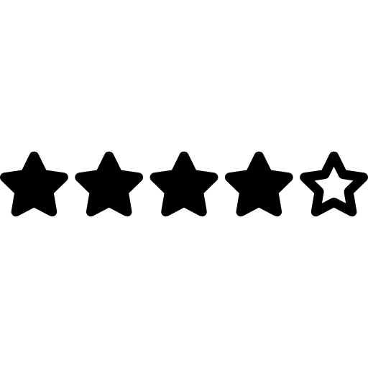





Intro
Rating
Check the usability of the application
Loading page
Login Page
Tester
Bug Tracking System
The gateway to users profile.
Responsible for discovering bugs
Developer
Administrator
Responsible for solving bugs
Monitors and maintain the system

Slide 5
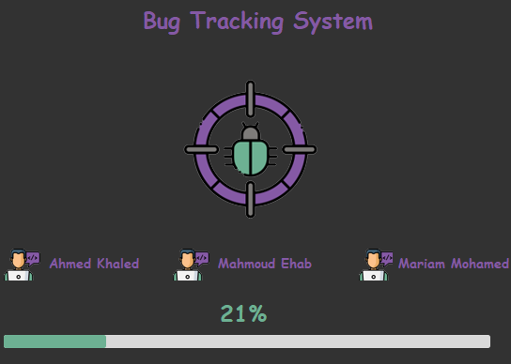
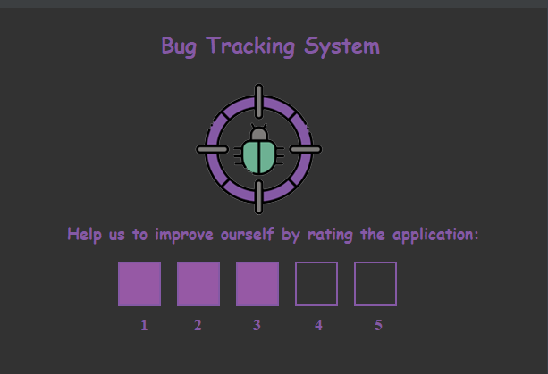
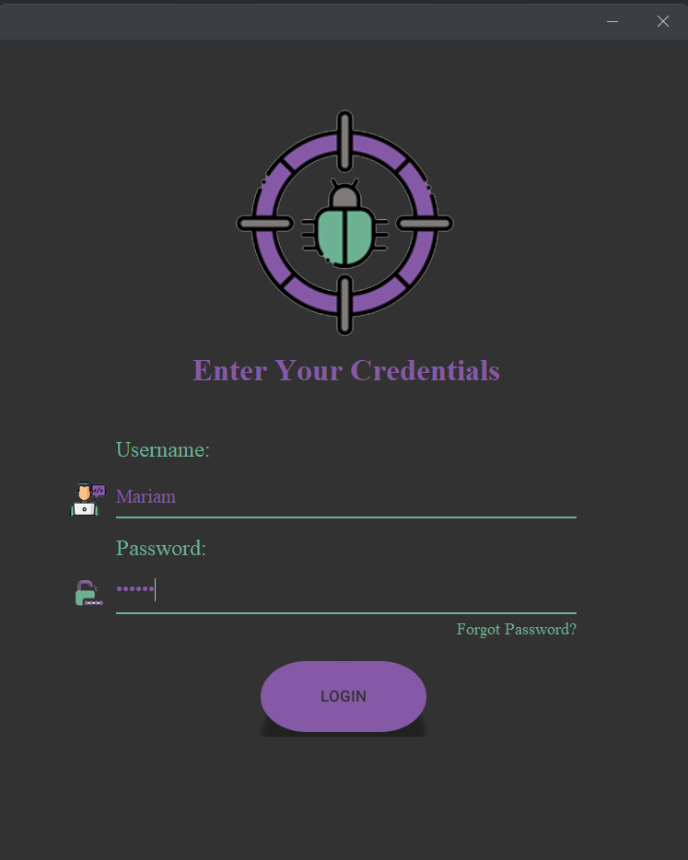
Main modules
Intro
Rating
Login

Slide 6



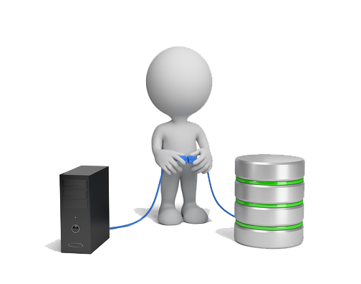
Intro page
Administrator
Login page
Tester
Developer

Slide 7
Intro page

Slide 8
Login page
The gateway to user profiles.
Prevents unauthorized access.
Notifies the administrator when a password reset is needed.

Slide 9
Login page properties
Right credentials:
1
If the credentials are right , user’s module will appear
Wrong credentials:
2
You have only 5 trials for login before the application stops working.
Forgot Password:
3
If the user forgot his password , he could ask for a new one.

Slide 10
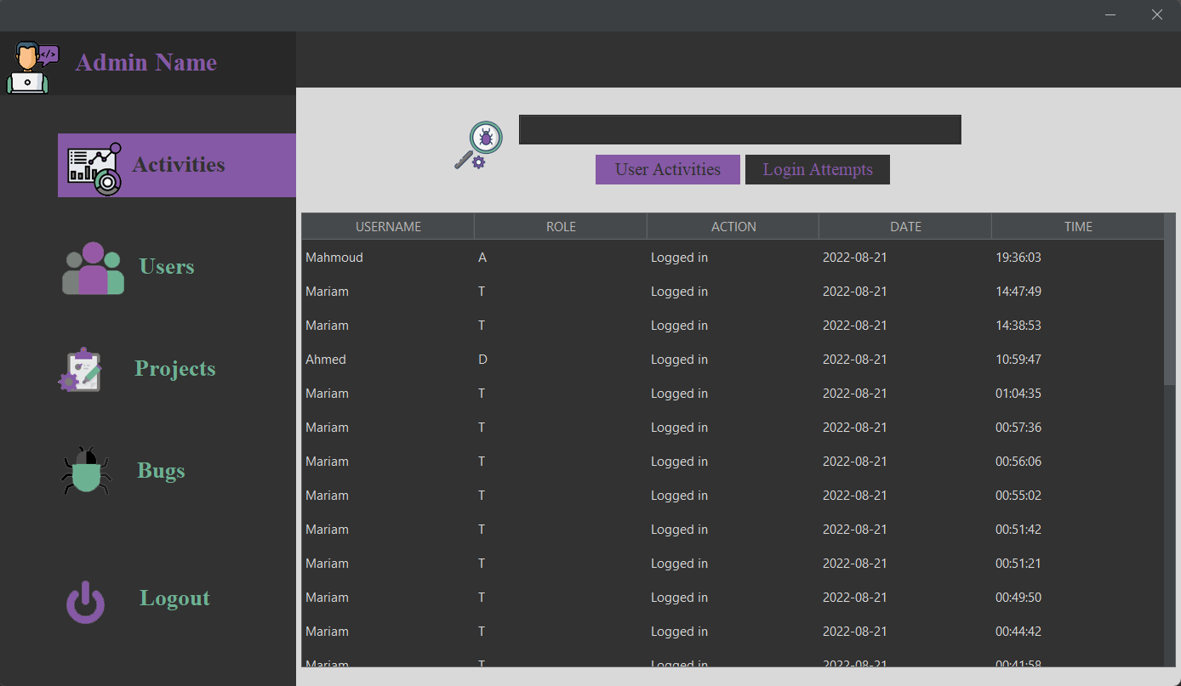
Administrator
Monitors and maintains the system.
Adds new users.
Edits and deletes user information.
Creates projects.
Updates and terminates projects.
Adds bug information.

Slide 11
Administrator page properties
View activity table:
View the whole bug table:
1
The administrator can view the activity of other users.
6
The administrator can view the whole bugs in the system with its details.
View login attempts table:
Update bug severity& severity:
2
The administrator can view requests of changing passwords.
7
The administrator can update bug severity , type & status.
View the whole users table:
View the whole projects table:
3
Only the administrator can view the whole in the system with its details.
8
Only the administrator can view the whole projects in the system with its details.
Add new users & update their details:
9
Create projects & assign it to user:
4
Only the administrator can add a new users to the system with their details & have the access to update these details or delete this user.
Only the administrator can add a new project to the system and assign it to different users.
Delete users:
10
Update Project information & delete project:
5
The administrator can delete all the users in the system.
Only the administrator can all the projects in the system & Update project information

Slide 12
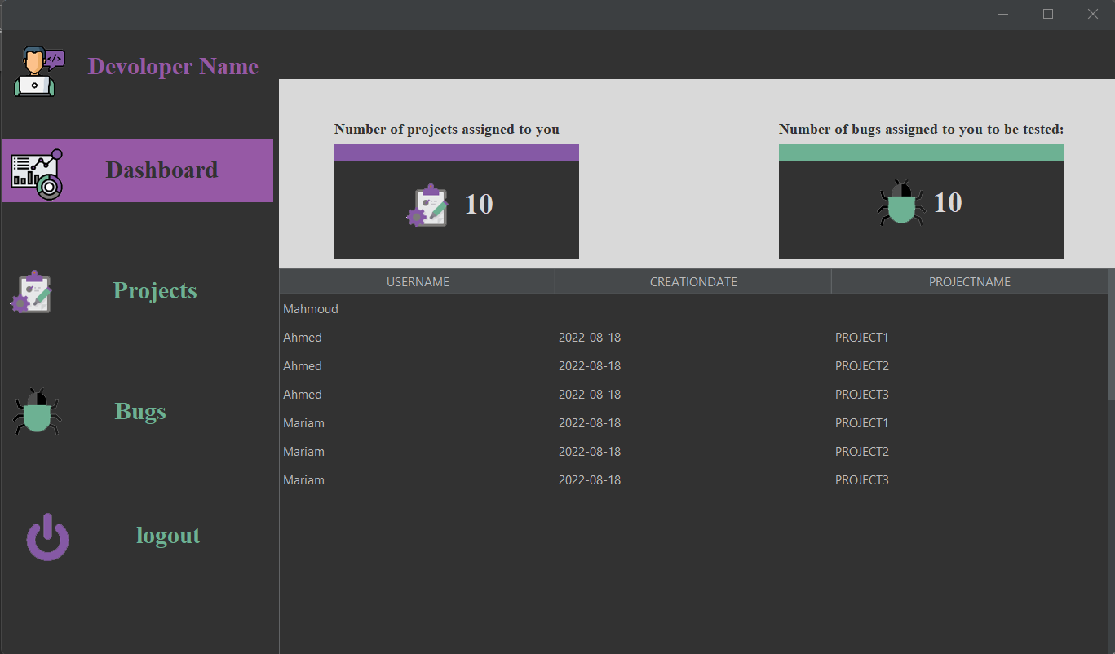
Developer
Responsible for solving bugs.
Views assigned projects.
Updates assigned bugs status.
Changes profile password.

Slide 13
Developer page properties
Reset Password:
1
Only developers has the access their passwords ,but the administrator will receive a notification when this action happens.
View assigned projects table & view the other assigned developers in the same projects:
2
The developers can view the list of assigned projects which have been assigned by the administrator & can also view the other assigned developers in the same project to make the communication between them smooth , easy & simple.
View assigned bugs table:
3
The developers can view the list of assigned bugs which have been assigned by the administrator
Update bug status:
4
The developers have the access to update the assigned bug status from in progress into to be tested after adding the solution of this bug.

Slide 14
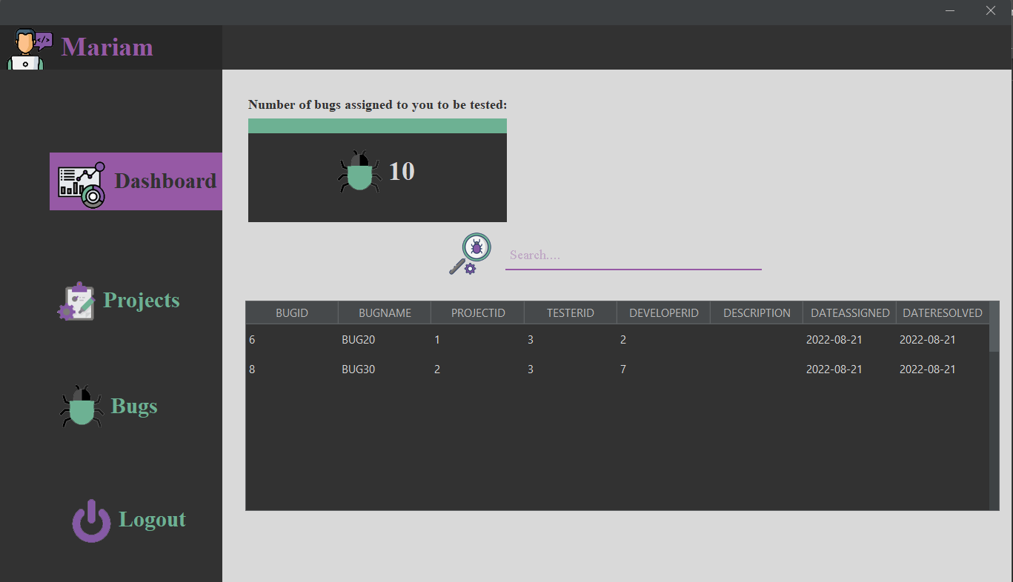
Tester
Responsible for discovering bugs.
Views assigned projects.
Adds bug reports to the system.
Checks added bugs status.

Slide 15
Tester page properties
View an overview pie chart of bugs status in specific project
View Assigned bugs table:
1
The tester can view a table of assigned bugs in the dashboard
6
Only testers have the access to view an overview of bugs status in a specific project
View assigned project table & view the other users in the same project:
Report Bug:
2
Only the testers have the access to create a new bug and add its details.
7
The Tester can view the list of assigned projects which have been assigned by the administrator & can also view the other assigned users in the same project to make the communication between them smooth , easy & simple.
Update bug details:
3
Only the testers have the access to update bug details.
Update bug status:
4
The tester have the access to update the assigned bug status from To be tested into closed reviewing the solution of the developer.
Delete bug:
5
Only the testers have the access to delete a bug from a specific project.

Slide 16
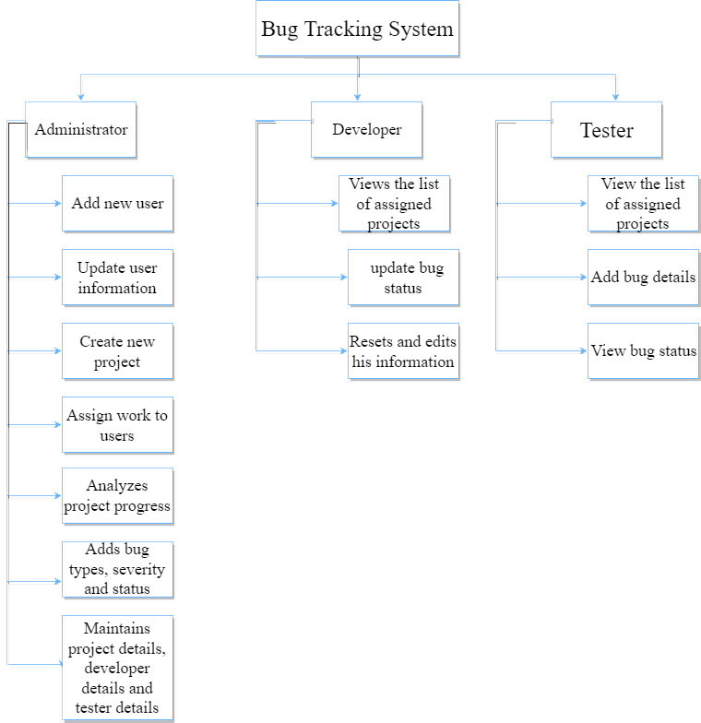
Abstract

Slide 17
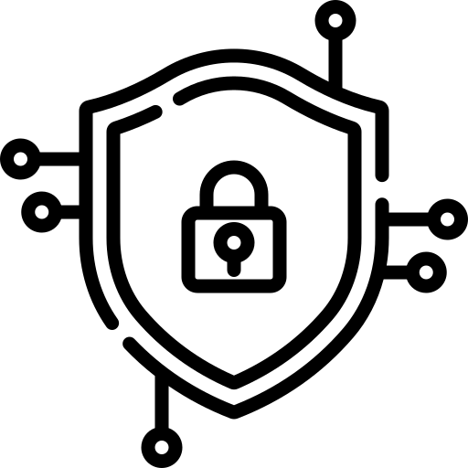





Non-Functional requirements
Security:
Availability
Usability
portability
Maintainability
The system is a desktop application can run on several operating systems.
The system consists of modules every module consists of classes in order, so the system is easy to maintainable.
No one can access the system from outside the company
The system is easy to use, and the modules are so simple
The system should be available during working times

Slide 18
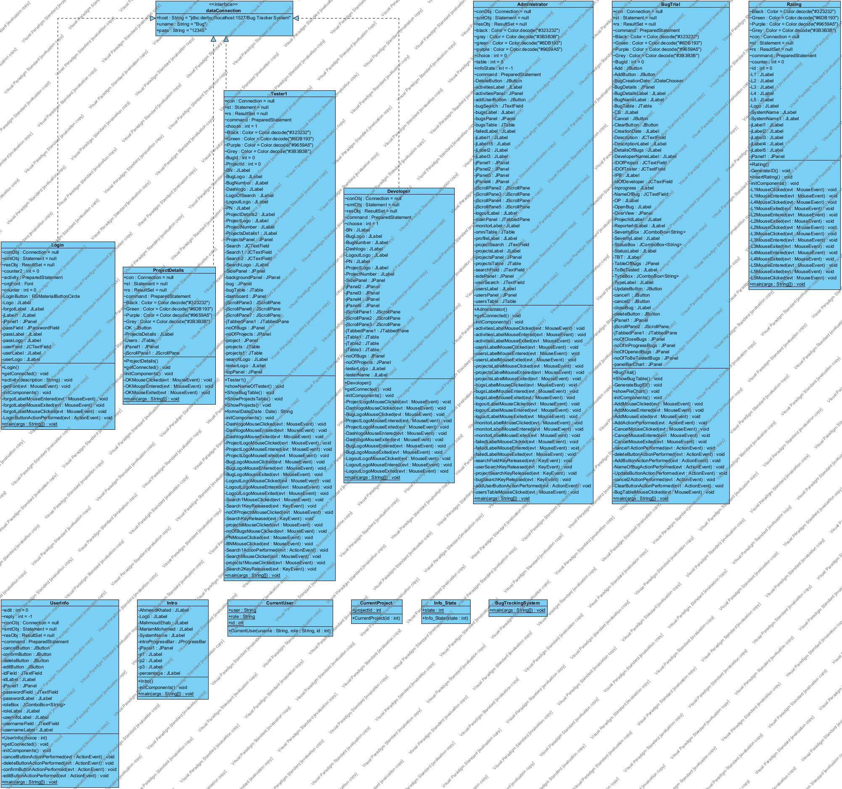
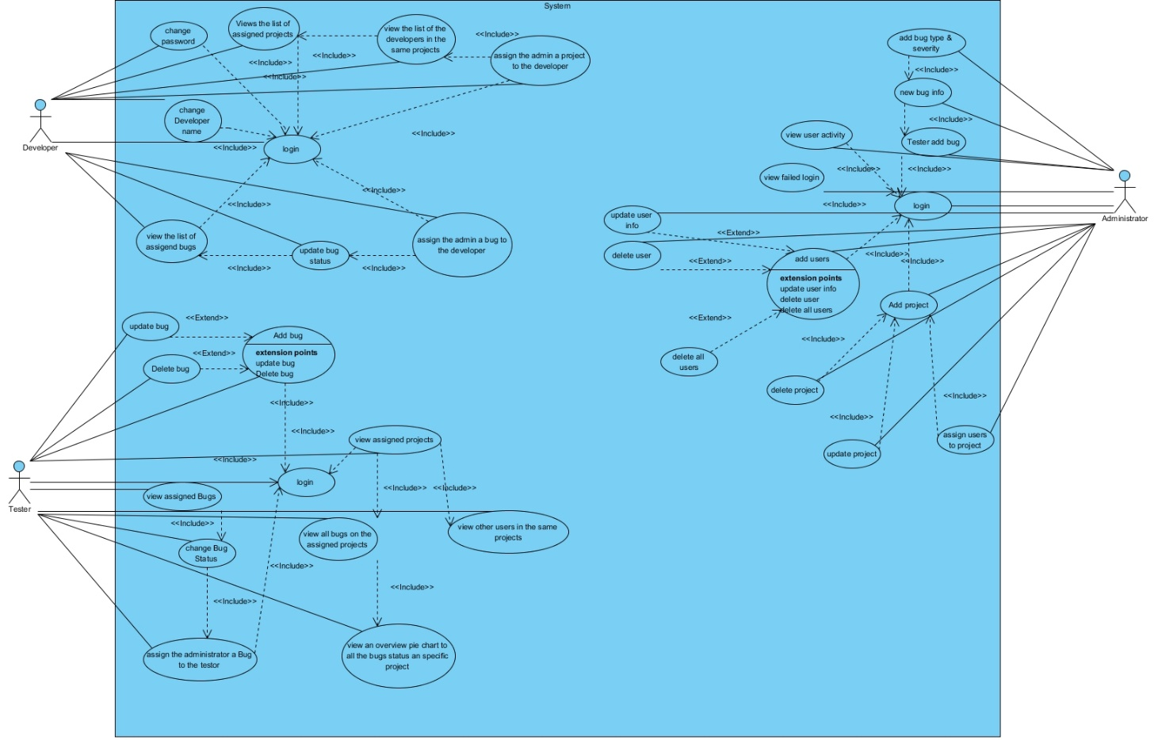
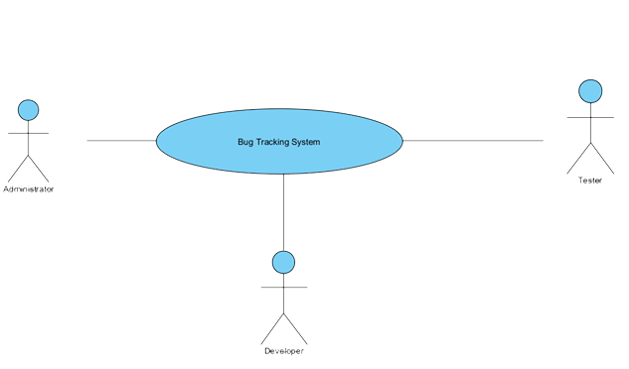

Slide 19


